Slide 1
Cloud Solution for Below Case Study
React Web app, deployed as a Single Page Application
Backend Service #1 –
Has its own Database
Accept Webhooks from the bank
Provides an API that is only available internally within the solutions
This Service should not be able to connect outbound to the public internet (except IP Range of the bank, 203.0.113.0/24)
Backend Service #2, which implements an API for the web app to consume
Has its own database
Provides an API that is available externally (rate limited to 10rps)
Service can freely connect with outbound to public internet

Slide 2
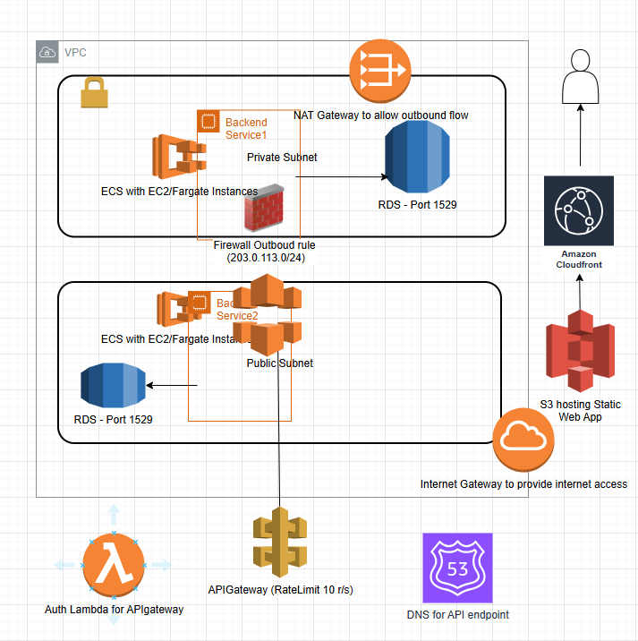
AWS Solution for Case Study

Slide 3
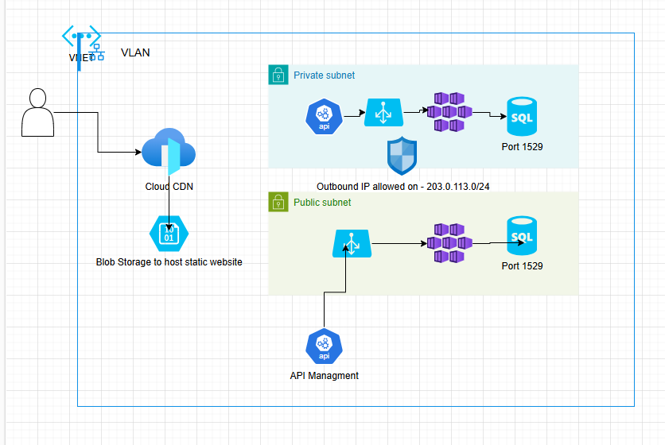
Azure Solution for Case Study

